Slide 1

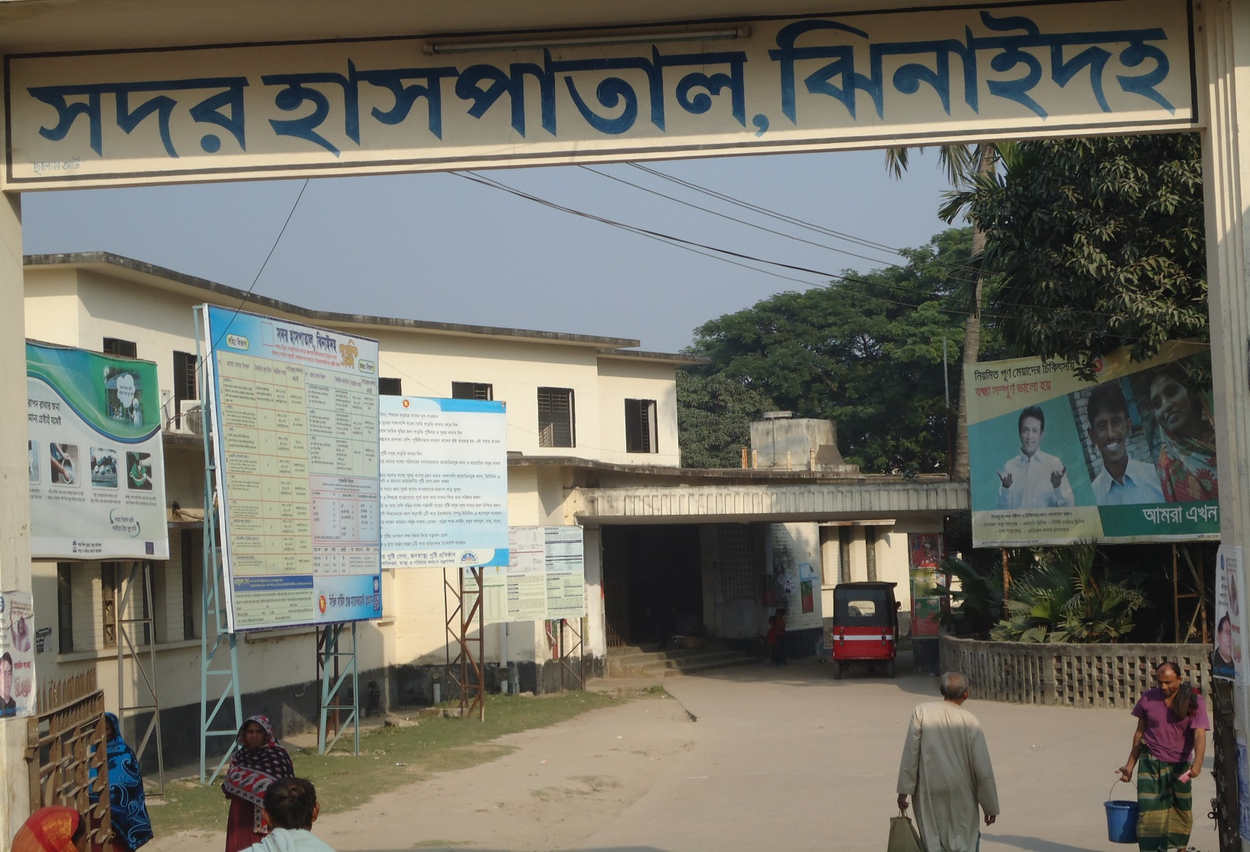
SADAR HOSPITAL, JHENAIDAH
Dr. Md. Emdadul Haque
Senior Consultant (Obs & Gyn)

Slide 2
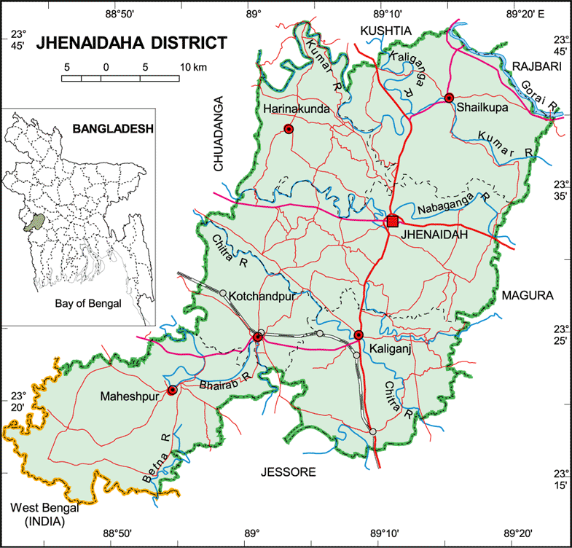

Slide 3
A District level Patient-Friendly Hospital with a Vision …
Maximum utilization of Govt.
resources with
honesty and sincerity
Integrated approach of
Administration, Community
Leaders & Health
Management
Providing Effective and
prompt services
through improved
management system
Show respect to the
patients
Develop as a model District
Hospital in Bangladesh

Slide 4
Human resources of Jhenaidah Sadar Hospital-2012
(100 Beded) ( 50 Beded )
Post Post Vacant
a) Doctors 42 22 2
Super 01 0 0
Consultant (11+10) 21 10 2
MO 20 12 0
b) Nurse 38 42 2
Super 01 0 0
Supervisor 02 02 0
SSN/ JN (35+0) 35 (35+5) 40 2
c) 2nd & 3rd Class 30 20 3
Office Staff 08 04 0
MT +Pharma (6+3) 09 (3+3) 06 1
Others 13 10 0
d) 4th Class 40 24 0
Aya+Ward Boy (3+5) 08 0 0
MLSS+ Cleaner (5+8) 13 (10+7) 17 0
Guard 05 0 0
Cook 04 03 0
Others 14 04 0
Total Manpower 150 105 5
e) Non Govt Aya+ Cleaner+ Guard 41 0

Slide 5
Sadar Hospital, Jhenidah
Emergency, Out door & Indoor Service 1998 to 2012
Sl No | Year | Emergency Patients | Out door Service | indoor Service | Bed occupancy rate
01 | 1998 | 16733 | 65062 | 12973 | 126%
02 | 2009 | 23116 | 136464 | 19623 | 137%
03 | 2010 | 25868 | 123764 | 20384 | 136%
04 | 2011 | 28855 | 141999 | 22435 | 146%
05 | 2012 | 30001 | 141069 | 22951 | 143%

Slide 6
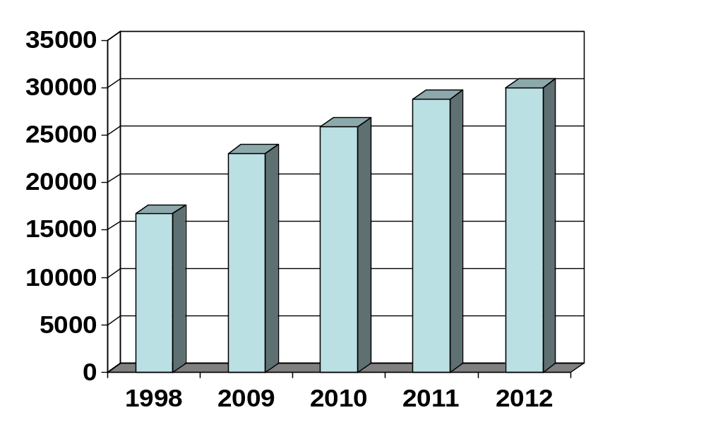
Emergency Patients
28855
30001
25868
23116
16733

Slide 7
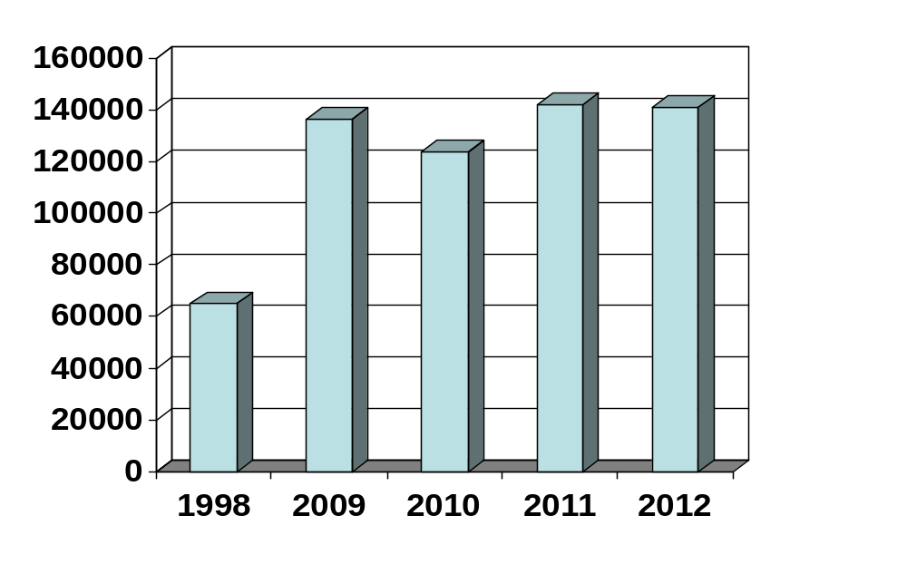
Out door Service
136464
141999
141069
123764
65065

Slide 8
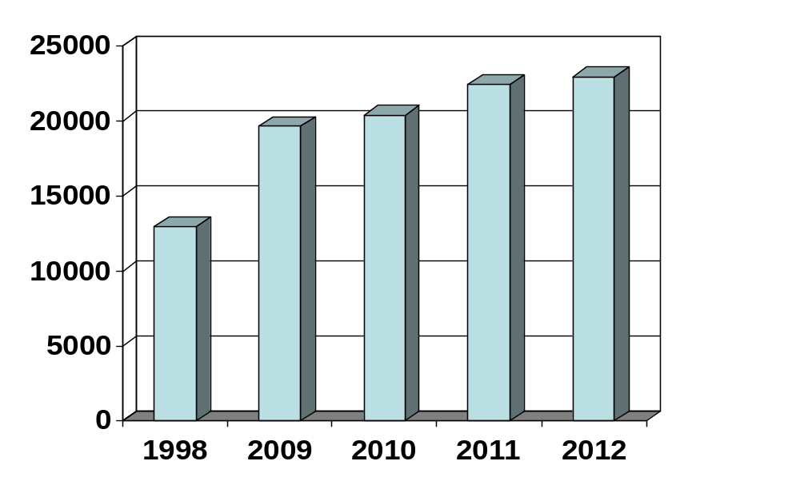
Indoor Service
22435
22951
19623
20384
12973

Slide 9
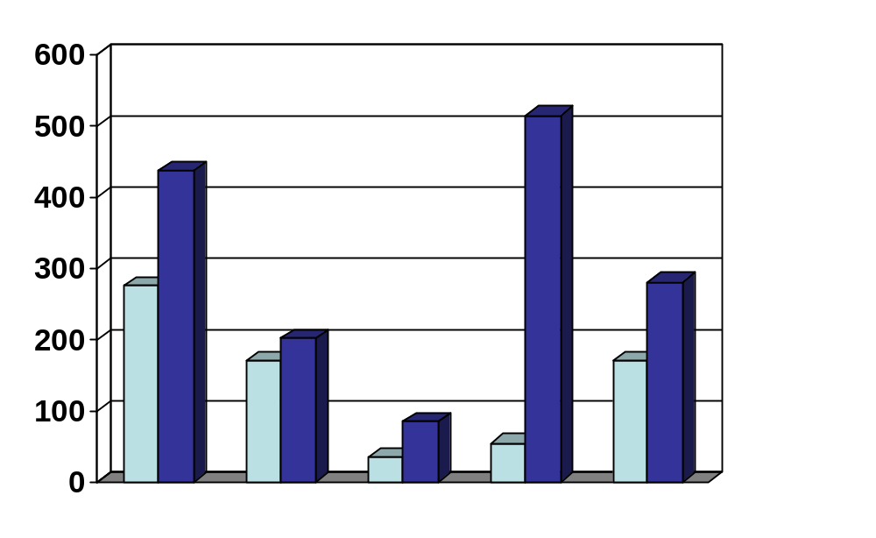
Sadar Hospital, Jhenidah
Comparative Data of EOC services in April,2012 & April,2013 at Jhenaidah Sadar Hospital
514
437
275
281
201
170
170
84
55
34
Admission
Total delivery
C. Section
ANC
PNC

Slide 10
Sadar Hospital, Jhenidah
Development in EOC Service in Jhenidah.
Introduce Labour Admission Register, Labour Ward Admission Form, Separate Discharge Form.
All EOC Related Patient kept in a ward.
Starting of ANC & PNC corner and Arrange a Room for Medical Officer.
NO. of EOC Bed increase from 10 to 21 though on EOC bed only 5.
Improve EOC Operation Theater.
Shifting of Labour room & arrange pre-labour room with three beds & maintenance of privacy.
Moral based environment with 7 (seven) workers supported by community donors.
Make a breast feeding corner & Provision of Vitamin A distribution for PNC Mother.
Starting of Health education system.
Set up of dropler machine & Ventouse Machince.
EOC Operation activities extended from 8 A.M. to 2 P.M to 8 P.M.
Ensuring Rational use of drugs in EOC ward.
Provision of Mobile Phone in EOC ward no. 01742732116.
Improvement of Eclumpsia room.
Provision of Emergency kit boxes such as PPH kit, Eclumpsia kit.
Shoe-free environment for infection control.
The center is used as a effective training center for SBA, Nursing student, Mid-wifiry.

Slide 11
Sadar Hospital, Jhenidah
Operation Service 1998 to 2012
Sl No | Year | Major | Minor | Total
01 | * 1998 | - | - | 1089
02 | 2009 | 891 | 3099 | 3980
03 | 2010 | 842 | 3276 | 4127
04 | 2011 | 780 | 4857 | 5629
05 | 2012 | 977 | 5433 | 6410
* There was no Anesthesiologist in 1998

Slide 12
Problems of Sadar Hospital-1
100 Beded Hospital running with 50 beded manpower since 1994.
There are 9 unit in hospital (wards 06, OT, Out door, Emergency) needs cleaners about 36 but there are only 7 cleaners.
There is no post of Aya, Ward boy, Security guard in the Hospital.
There is no post of indoor medical officer so hamper indoor service & night rounds.
One (01) anesthesiologist working for surgery, gynae, Orthopedics, ENT, Eye, 24 hours EOC & emergency service.
There is no effective waste management system.
Condemnation board is not working regularly due to administrative problems.
Many of the instruments and equipments are not functioning due to lack of bio-technologist & funds for repair.
There is no target for indoor-outdoor patient & huge number of indoor & out door patient creates a heavy loads for services providers .
MIS system is weak and there is no hospital action plan.
No client satisfaction survey system.
The number of nurses is very few.
Hospital health management committee & monthly co-ordination committee meeting is not perform regularly.
Female privacy is not properly maintained.
Insufficient in toilets & safe drinking water supply.
Influential person influence on tenders of drugs, free cabin & paying ward.
Auditing & accounting system is not corruption free.
Consultants & MOs are also the teacher of NTC, MATS etc. which affect hospital services.
Three doctors are illegally suspended.

Slide 13
Problems of Sadar Hospital-2
There is no visitor control system .
EPI, ORT corner, DOTS corner, VIA centre are running with least or no defined health personnel.
Health education systems is very poor .
There is no pediatrician in this Hospital.
There are 5 beds in EOC word, which is insufficient for 40000 pregnant mother per year in Jhenidah District .
There is no intercom system .
There is no IMCI corner for under 5 children .
Non health Issues get less importance.
Scarcity of blood in emergency need.
There is no adolescence health corner.

Slide 14
Sadar Hospital, Jhenidah
Community Support System in Sadar Hospital
Twenty eight (28) manpower (2000 Tk per month per person) is supported by Dr. Abdur Rahman (Anesthesiologist), Dr. Nasrin Sultana (Civil Surgeon ), Dr. Md. Emdadul Haque( Senior Consultant, Gynae & Obs), Dr. AKM Kamal (Cardiologist), Dr. Rased Al Mamun, Social Welfare Deptt. of Drug International Pharmaceutical ,Dr Sk Abul.Fattah (associate professor of medicine), Mr. Nasser Shahrear Zahedee (Muhul), Chairman of Zahedee foundation, Mr. Konok Kanti Dash (Upazilla Chairman), Mr. Kahorsedul Alom Zinna.
Mayor of Jhenidah Powrshova Mr. Saydul Karim Mintu plays a major role in cleanness of the outer environment of the Hospital. Completed the broken boundary wall of the hospital and made 4 dustbin and repair the broken glass of the windows of female surgery ward, female paying ward and female medicine ward with a cost of nearly one lac taka.
Chairman of Zahedee foundation donates ten man power support and an intercom system for the hospital with a cost of nearly two lac taka.
EMOs of the Hospital repair their broken windows by self donation.
Mr Khandaker Faroquazaman (Farid) UP Chairman, Harishonkorpur, Jhenidah repairs 3 benches for seating of EOC outdoor patient.
Voluntary blood donors donates blood regularly .
Some of the Pharmaceuticals helps in forms and discharge certificate and seating arrangement
Mr. Shorahb Hossain (Sabu), Mr. Johir Raihan helps in butification and wall writing of EOC ward.

Slide 15
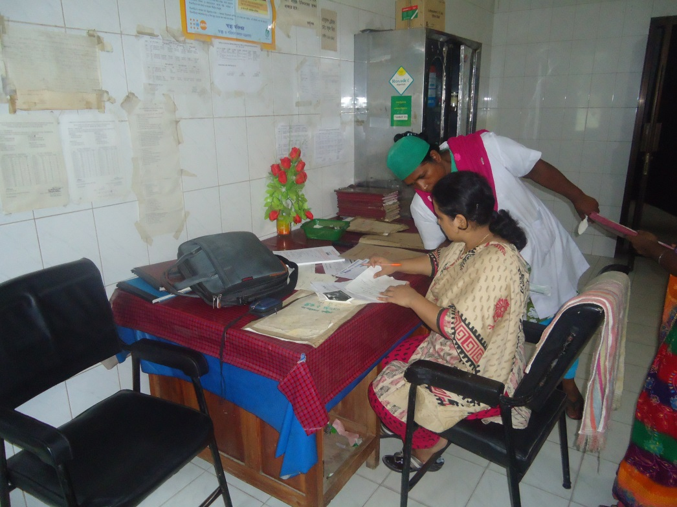
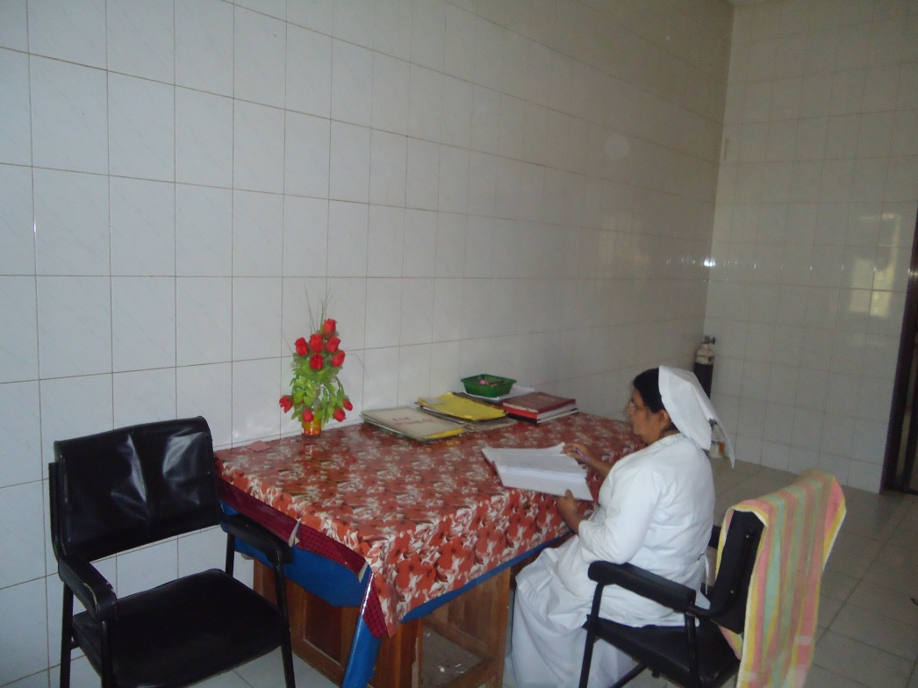
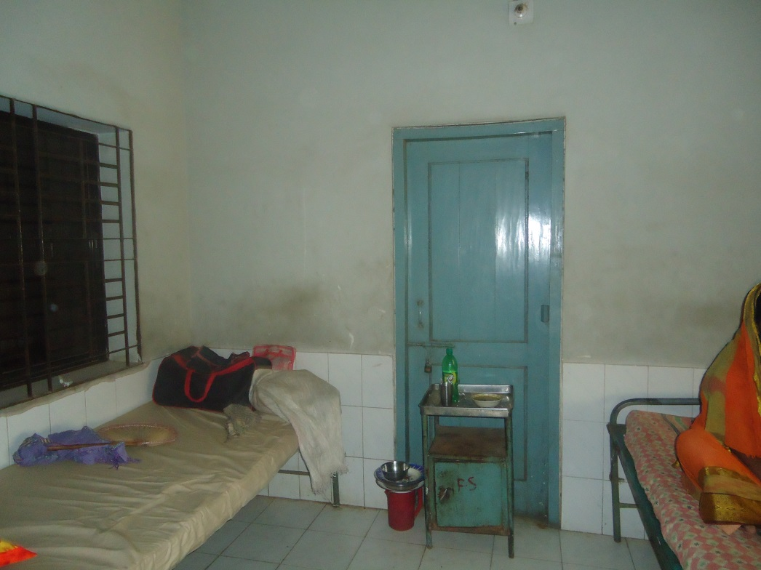
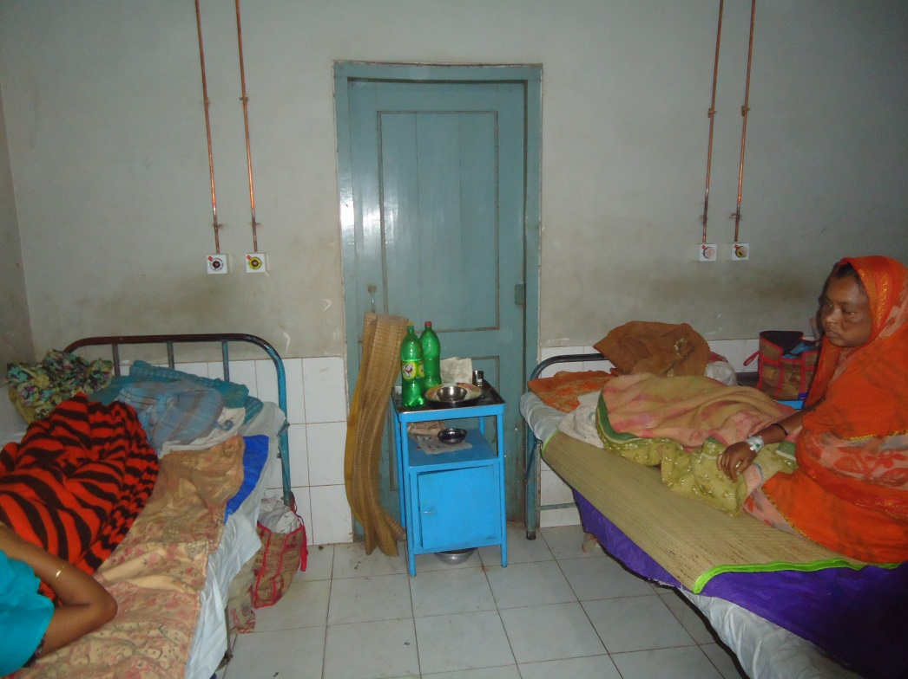
Before & After Situation

Slide 16
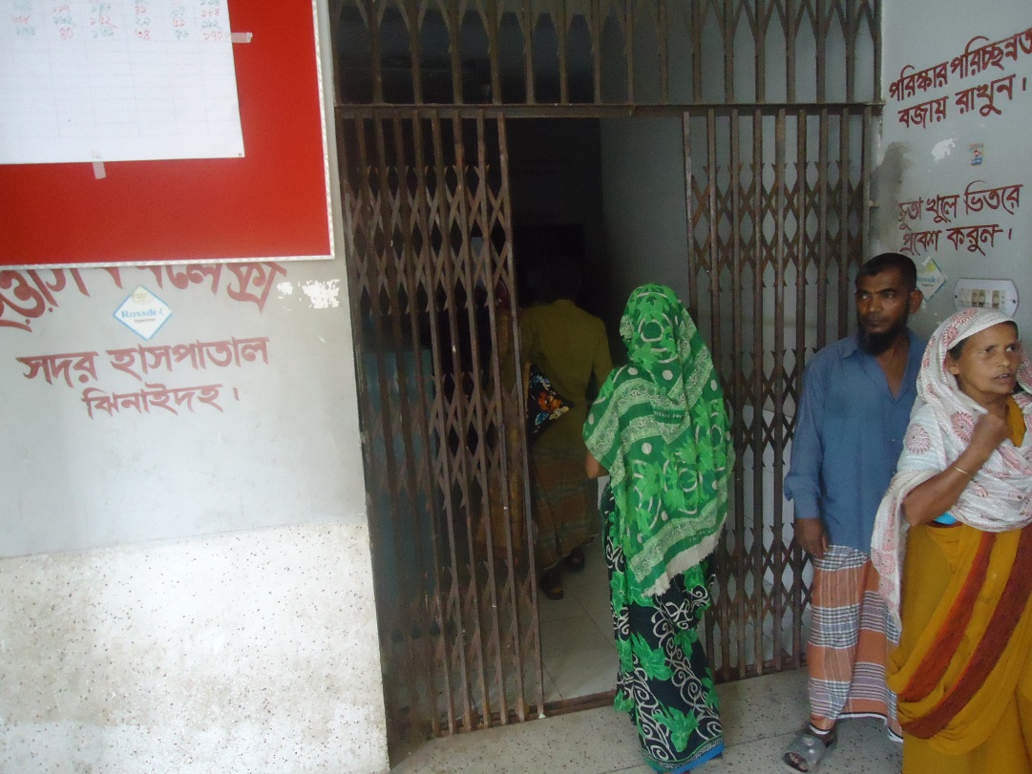
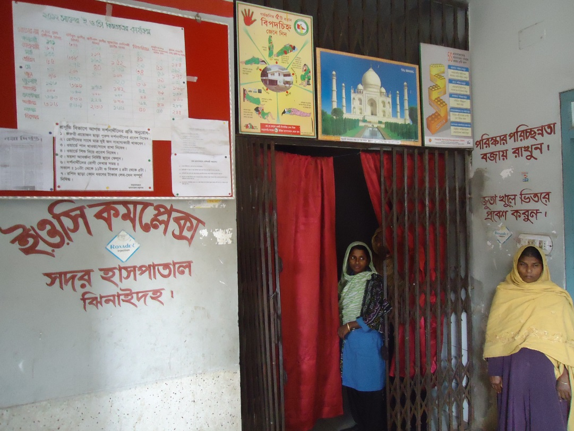
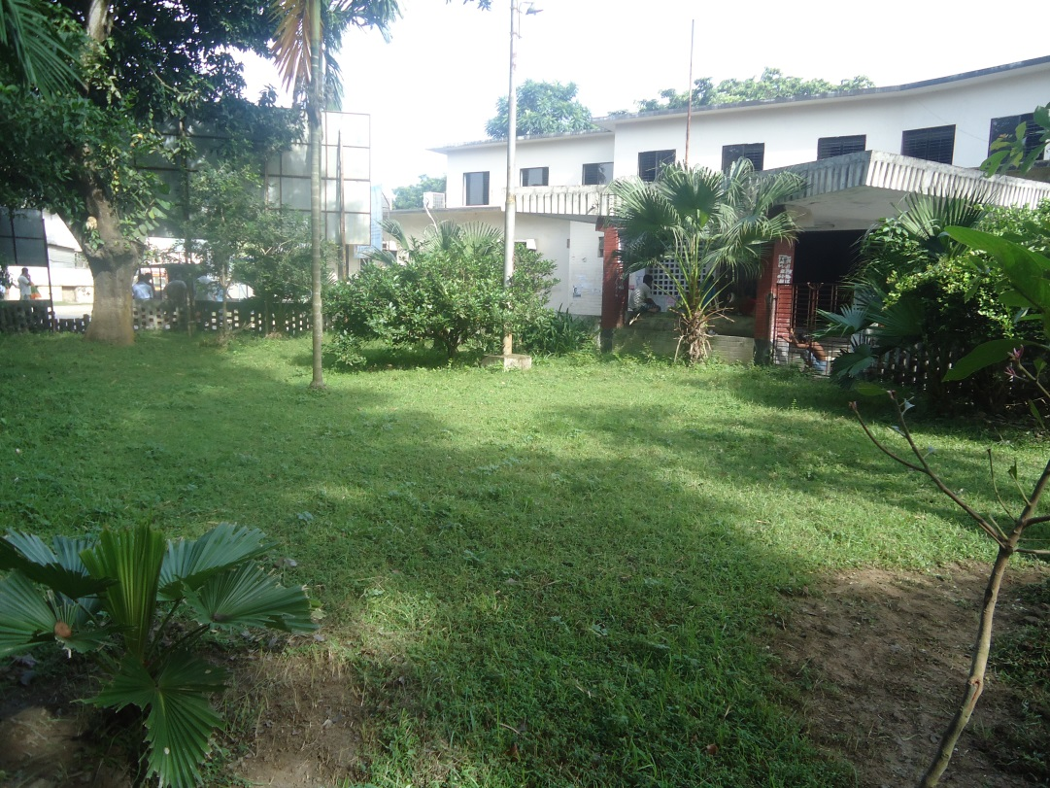
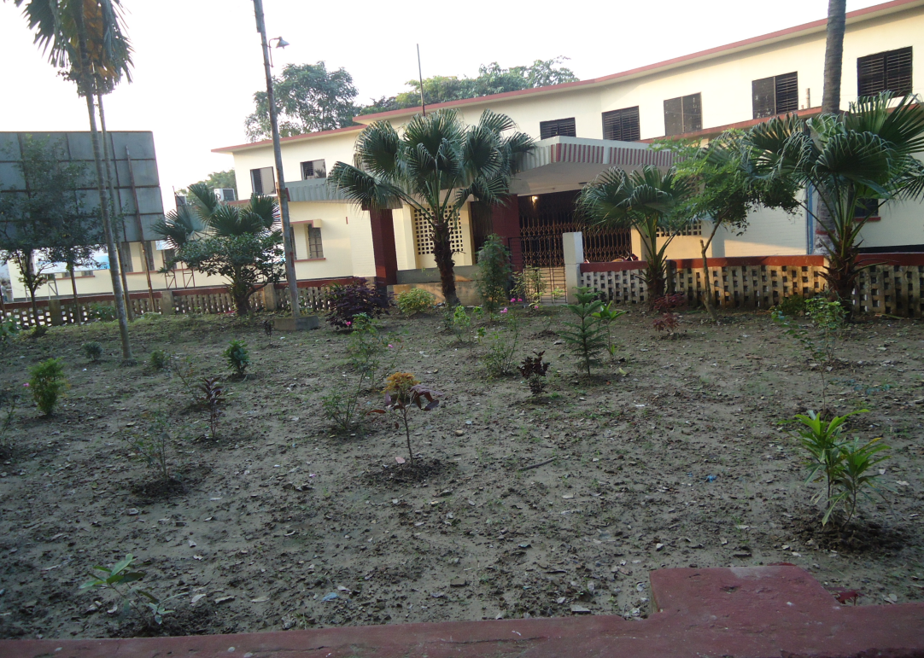
Before & After Situation

Slide 17
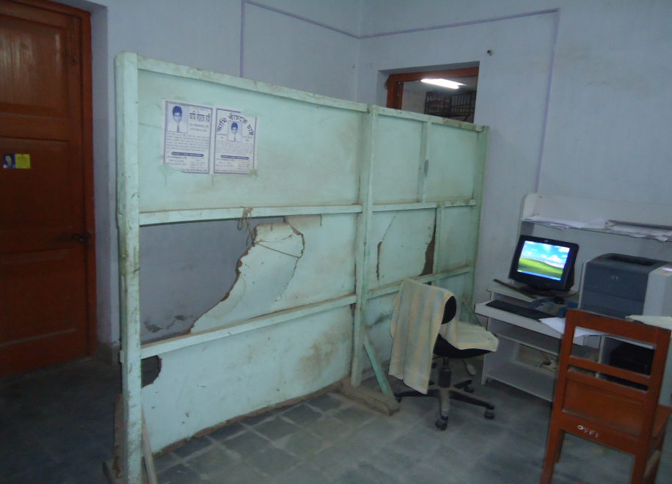
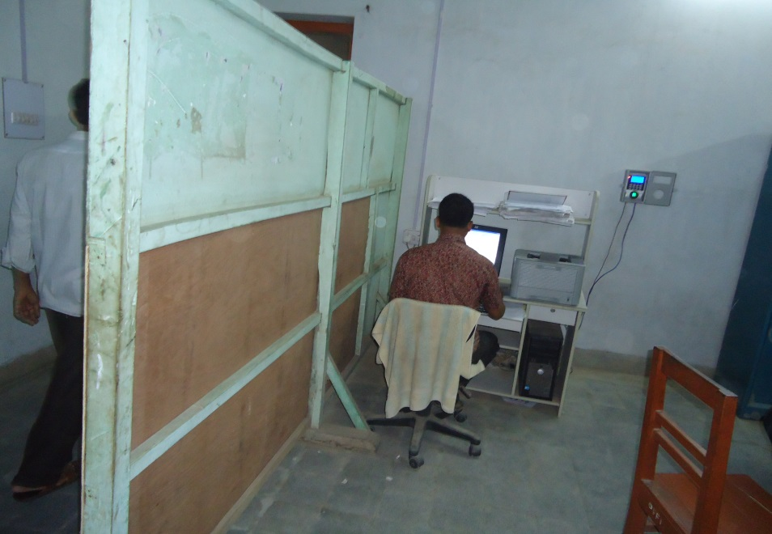
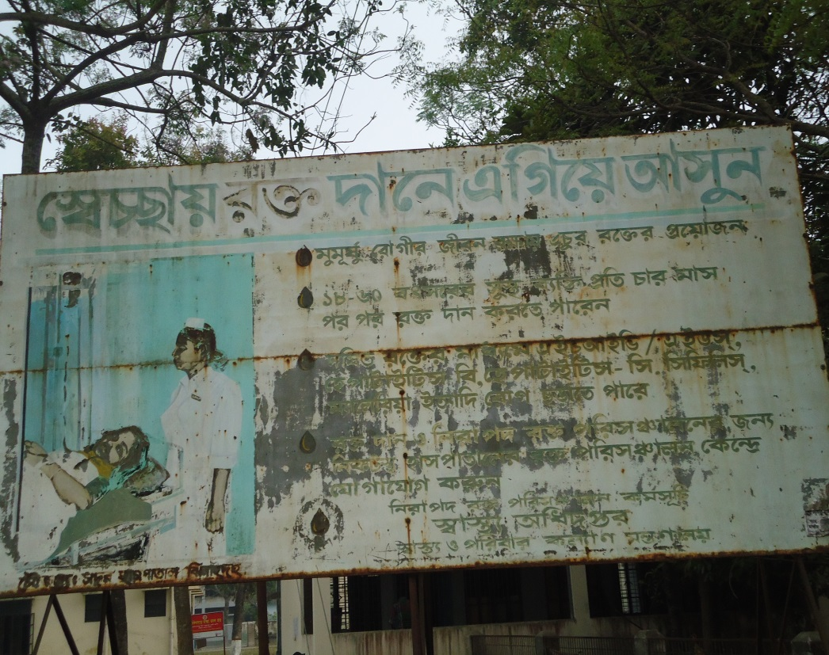
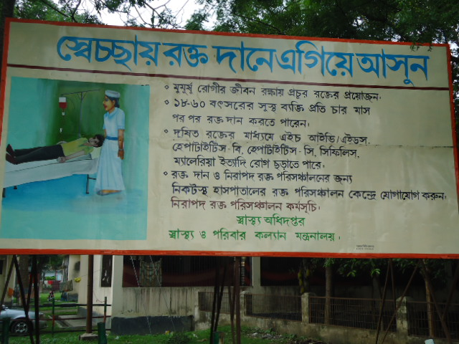
Before & After Situation

Slide 18
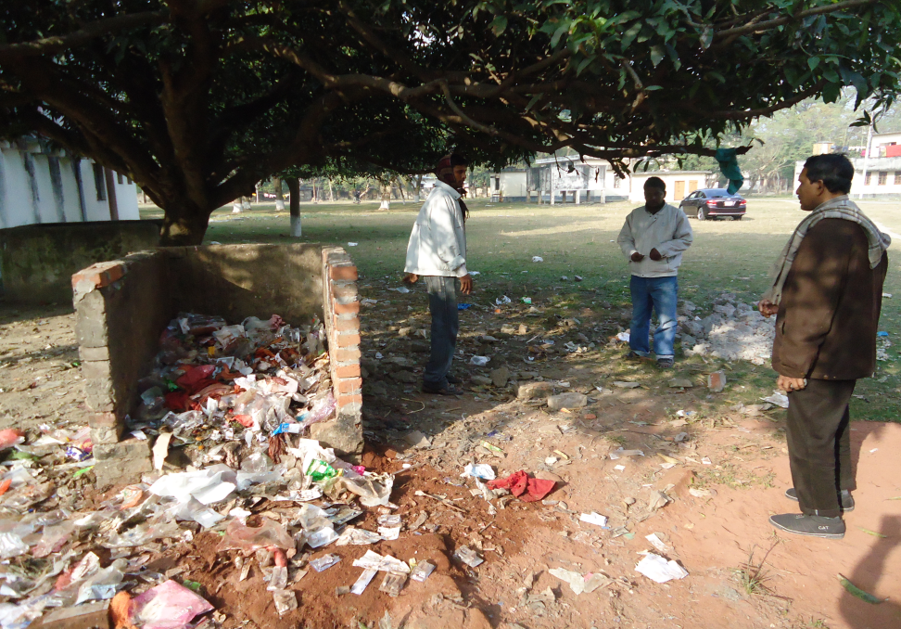
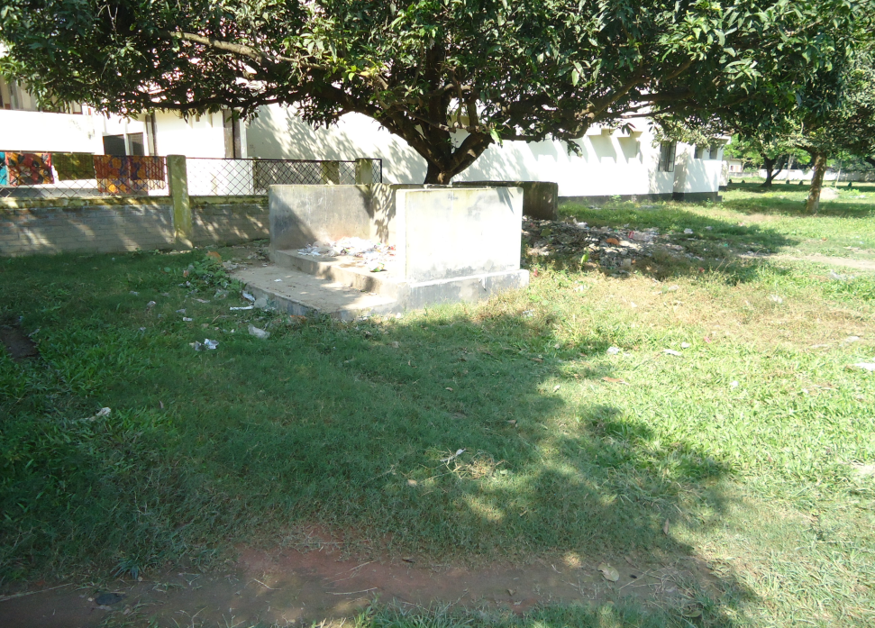
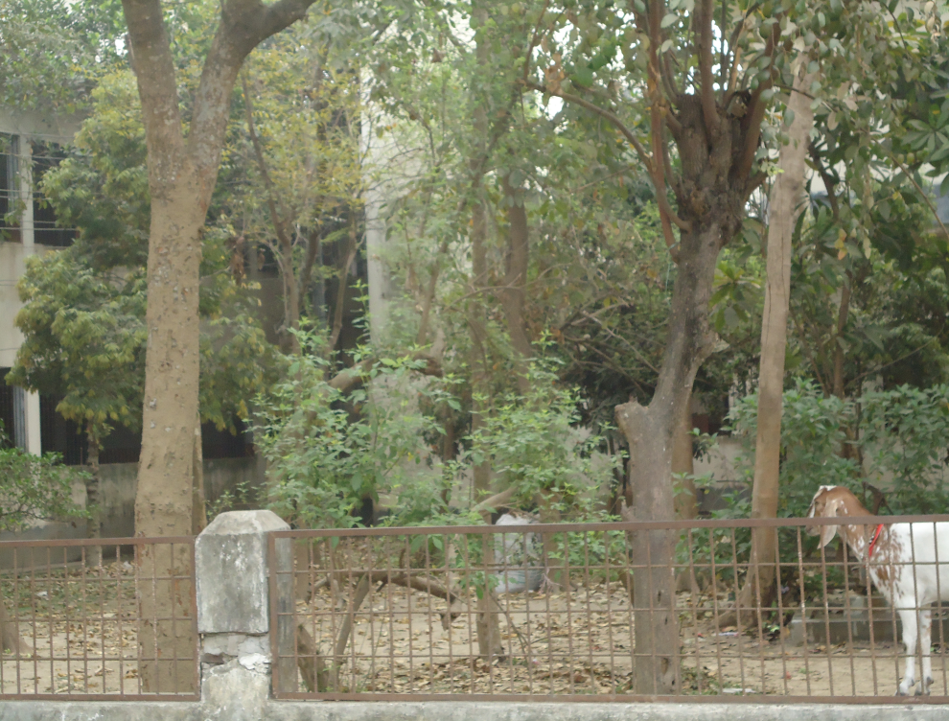
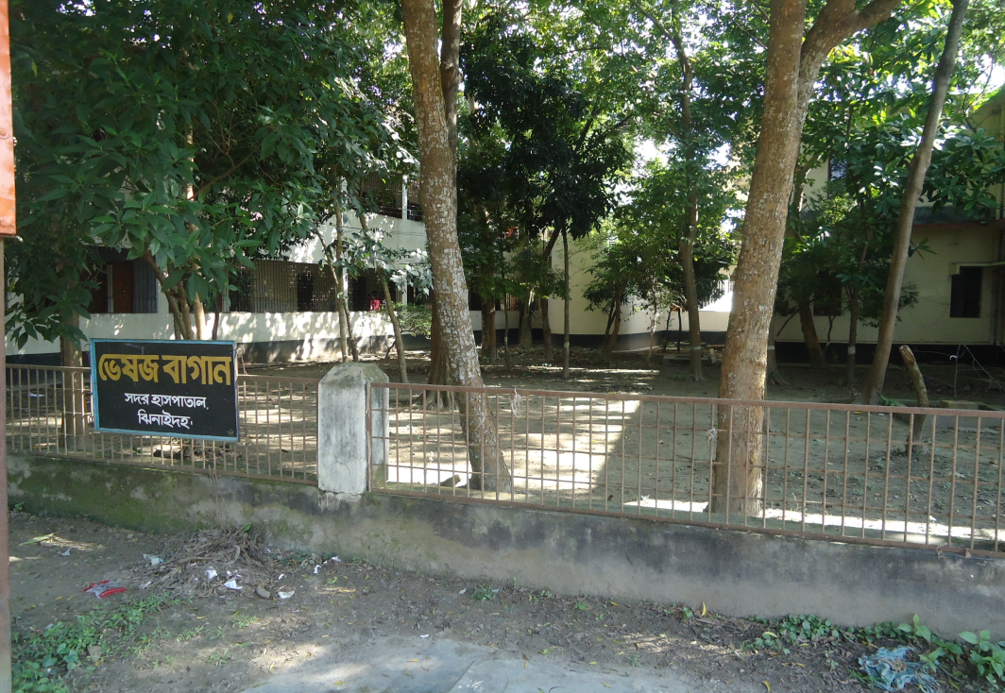
Before & After Situation

Slide 19
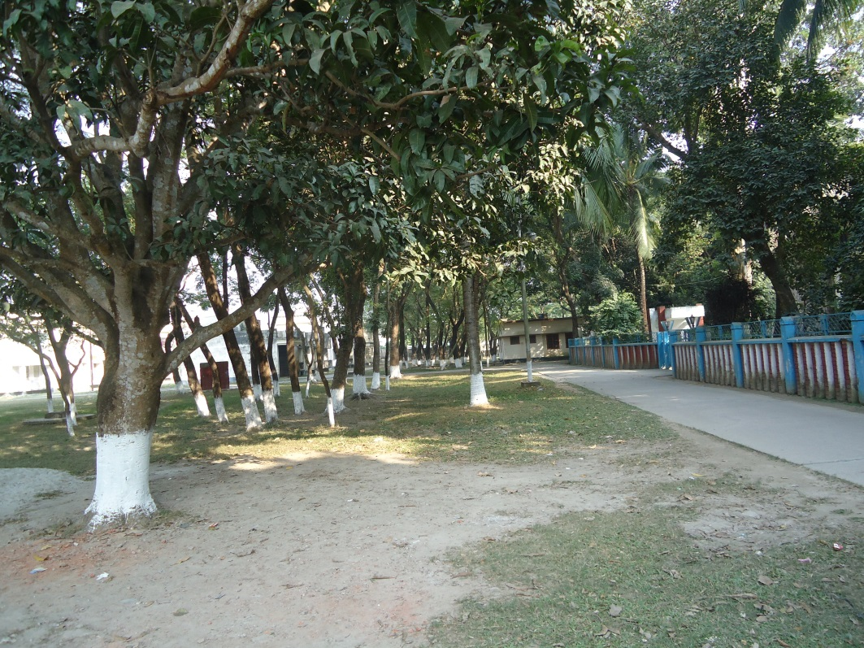
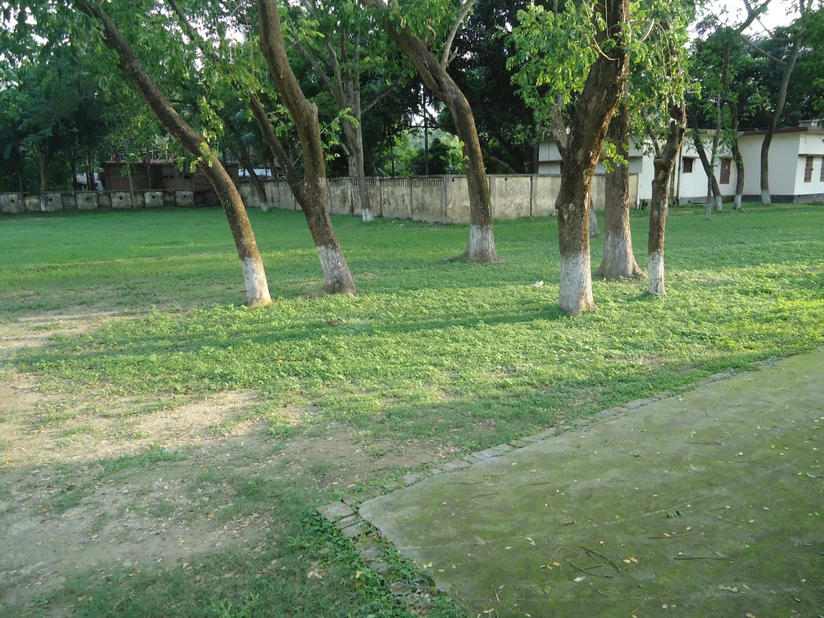
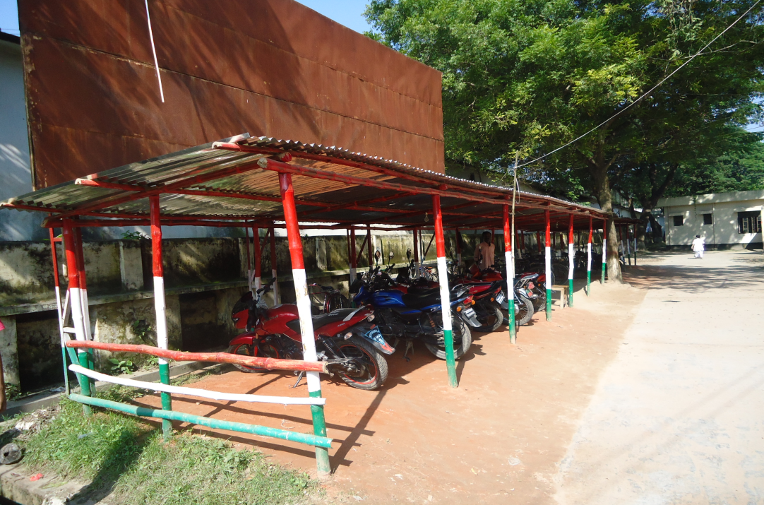
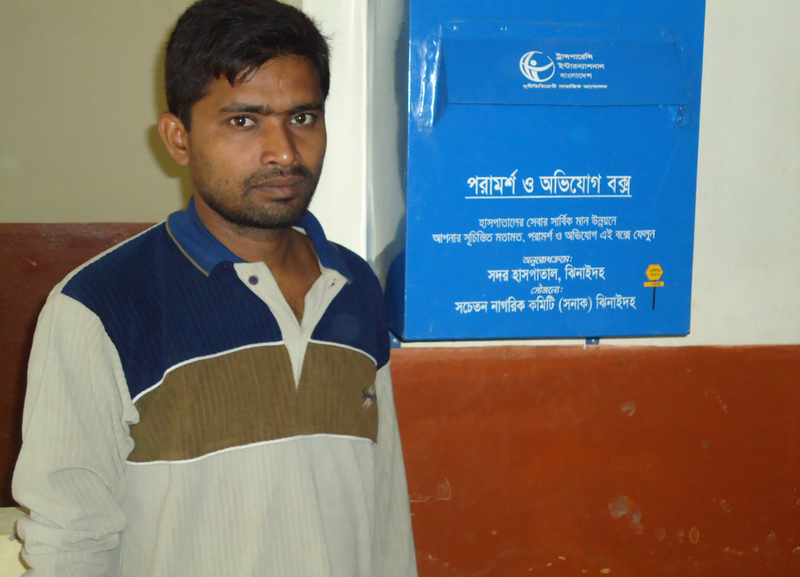
Present Environment of Hospital Campus

Slide 20
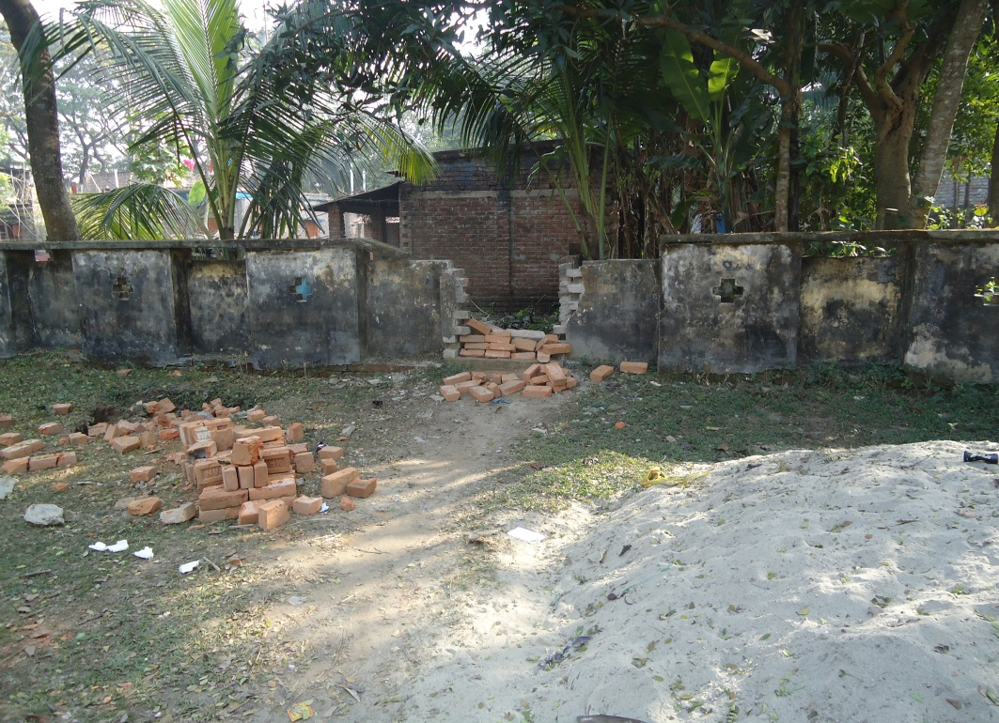
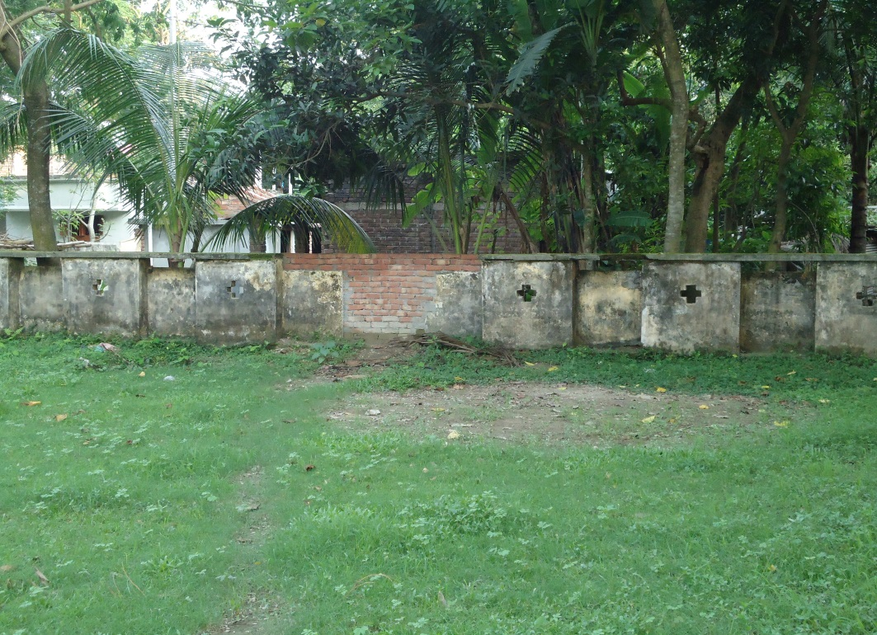
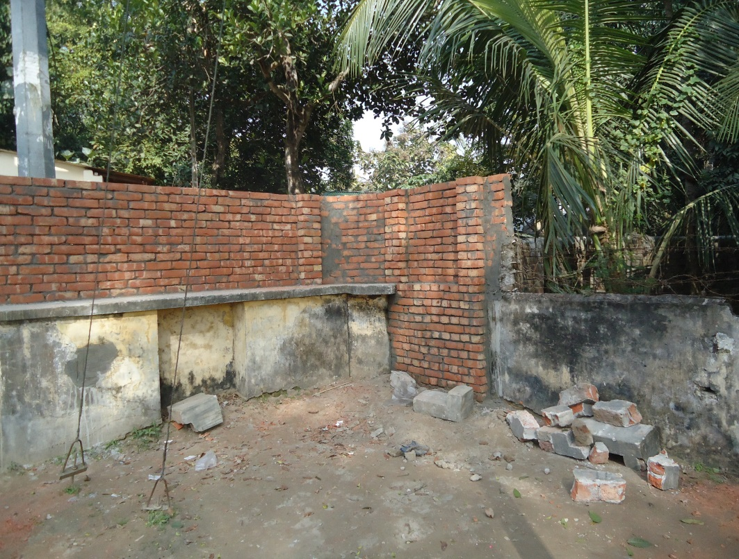
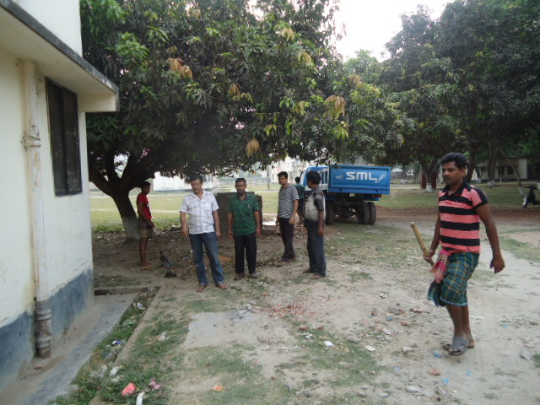
Local Govt. (Paurashava) Participation

Slide 21
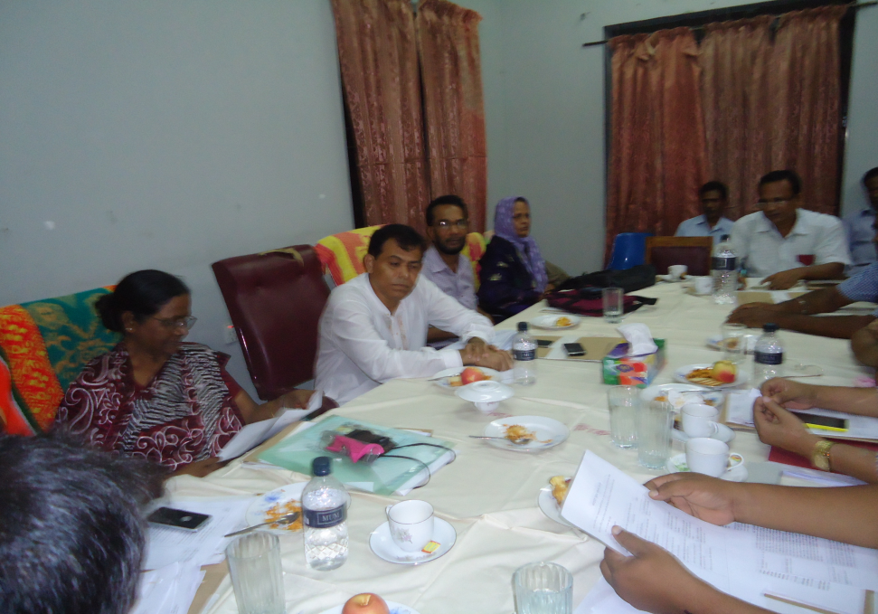
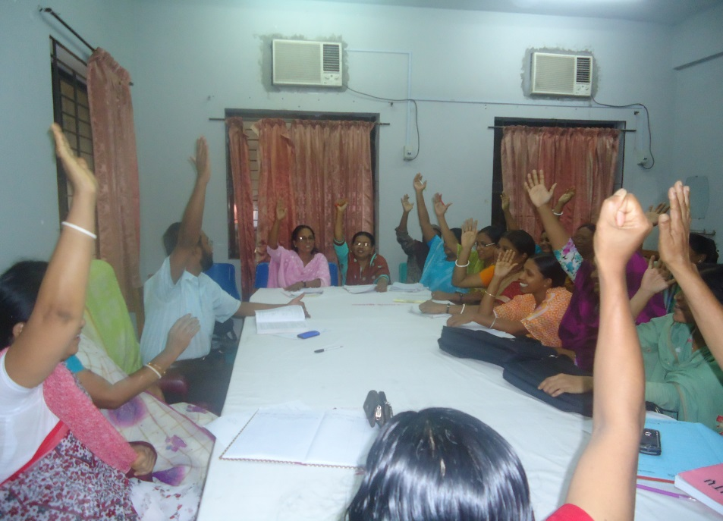
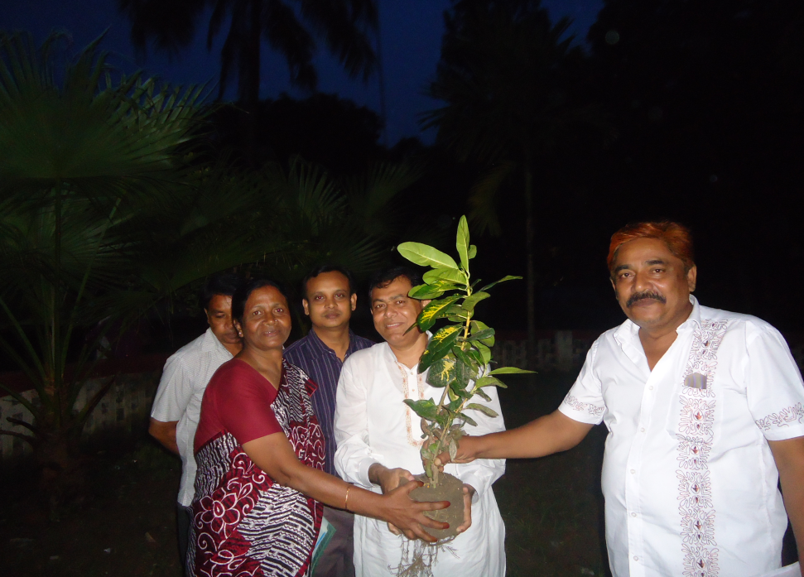
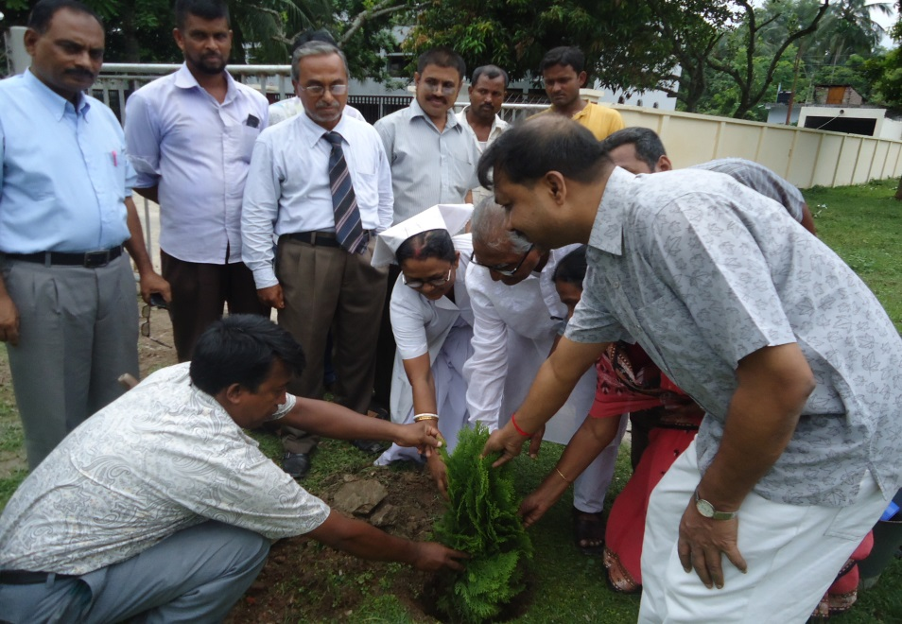
Community Involvement & Service Providers’ Commitment
Tree Plantation by MP and Community Leaders

Slide 22
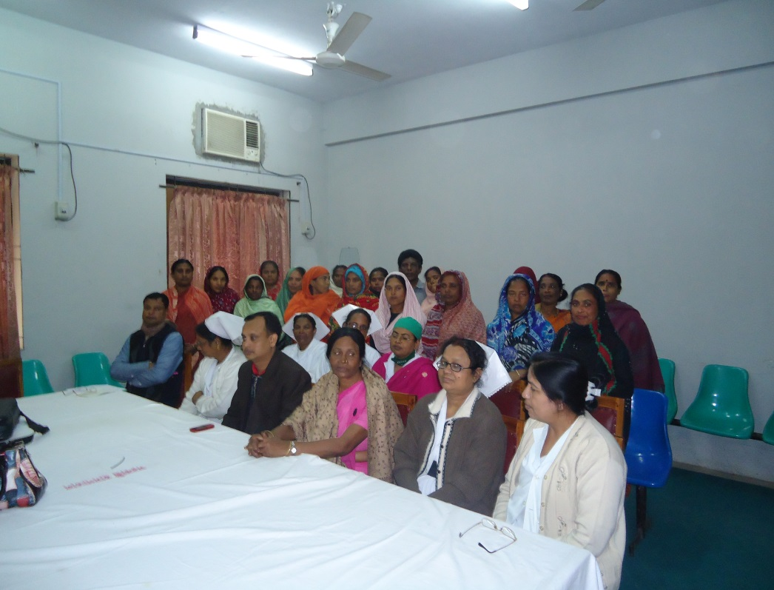
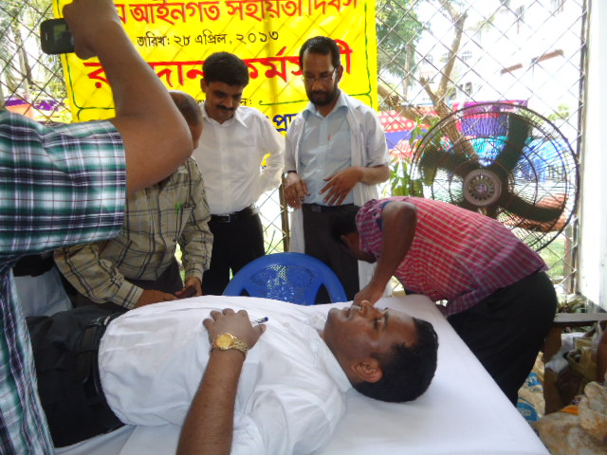
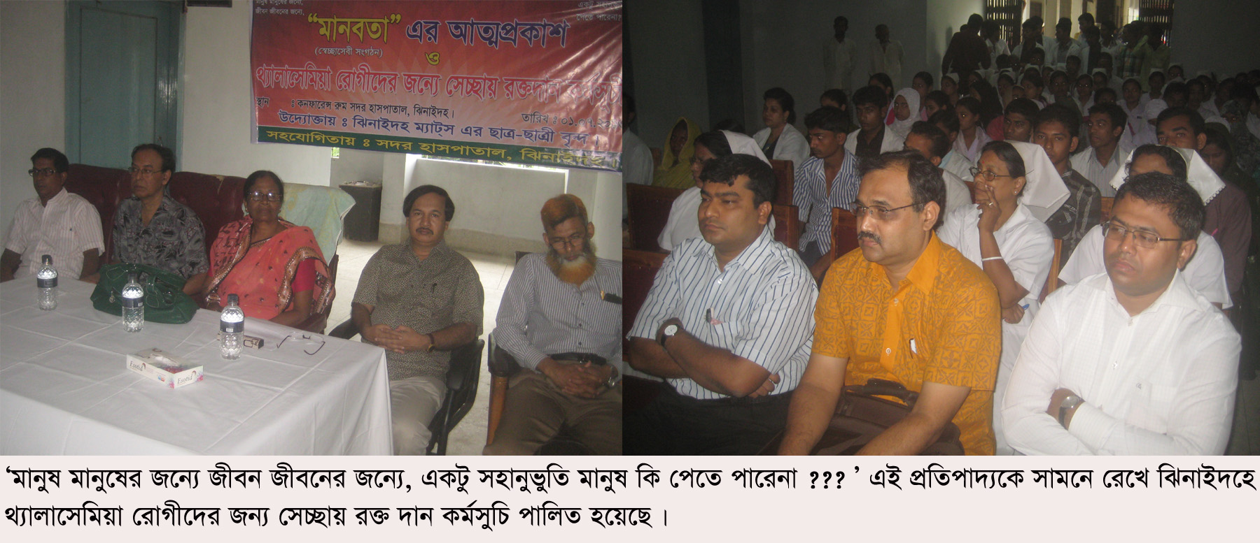
Blood Donation Program by Community

Slide 23
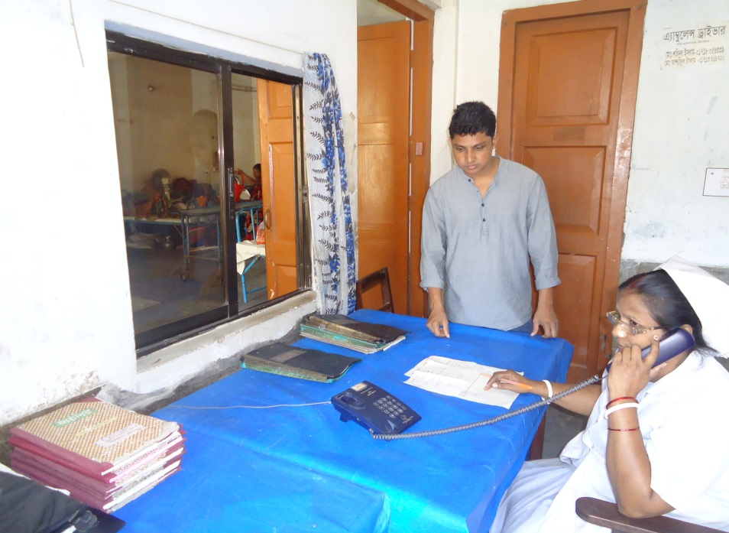
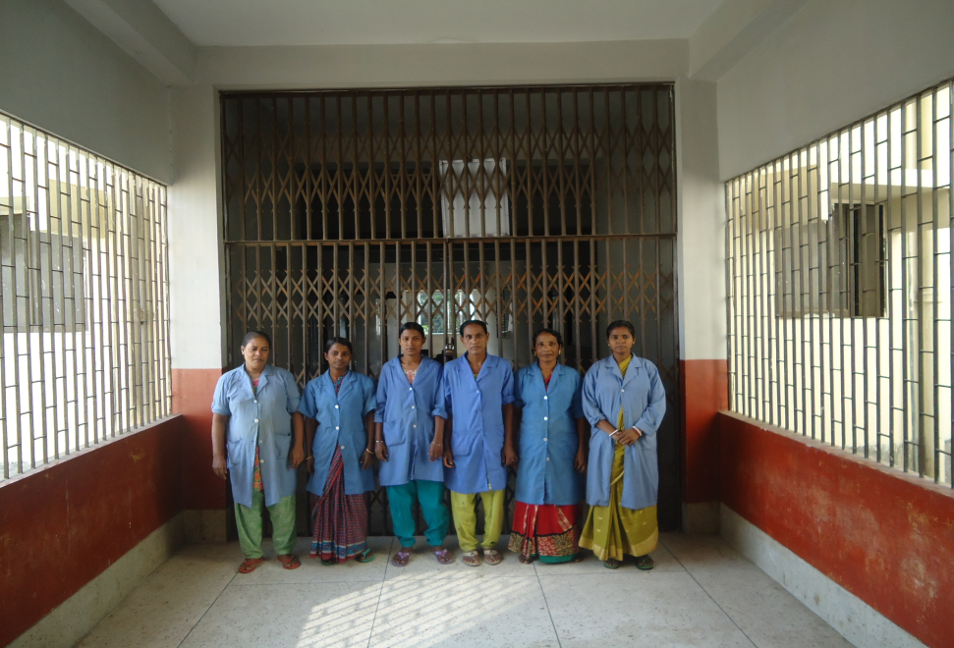
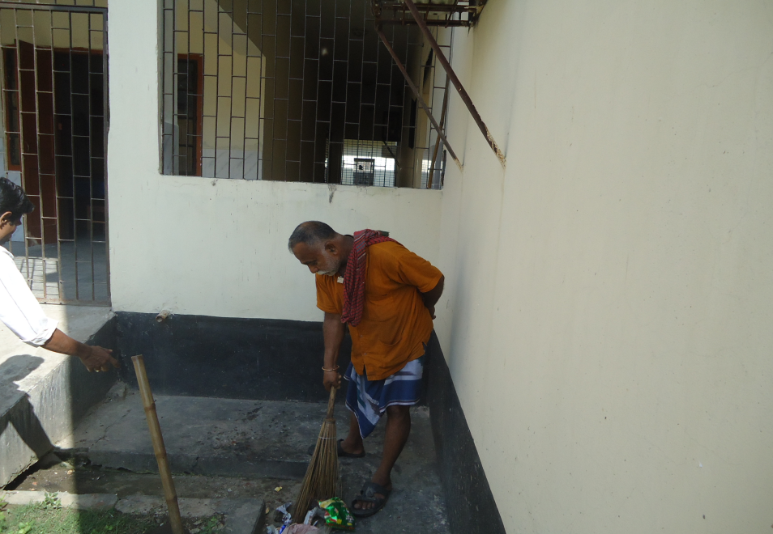
Community Donated Logistic and Manpower

Slide 24

Thank you

